Slide 1
Group 5 (SS6)
By:
Nicholas Chin Wei Lun
Sim Xin Ni Clodia
Tu Xia Yang
Vevek Salvam

Slide 2
Project 1
Integration of MergeSort and InsertionSort
Notes:
The purpose of this project is to integrate MergeSort and InsertionSort together so as to avoid the overhead of many recursive calls when the size of subarrays are very small in MergeSort.

Slide 3
Hybrid Sort Algorithm
Given threshold S, 1) Recursively divide the input array A
2) When the divided array’s size <= S, sort it with insertion sort.
3) Merge the individually sorted arrays together with merge sort.
Notes:
To start off, we will be explaining the algorithm behind combining the two together. The general idea is that we set a value to be S and we carry out mergeSort as per usual. However, once the array size gets divided until the subarray has a size smaller or equal to S, we switch over to insertionSort and sort it accordingly. When the subarrays are all sorted out in insertionSort

Slide 4
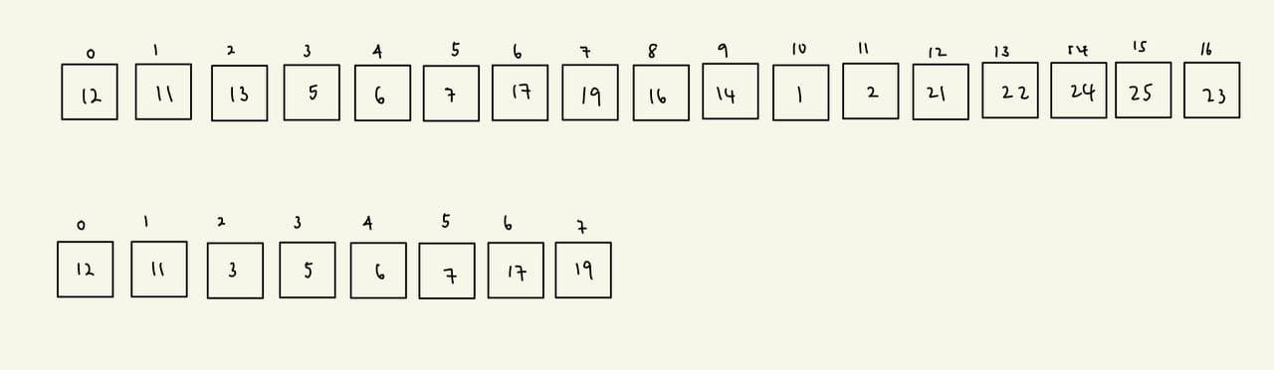
Taking S = 4;
Mid

Slide 5
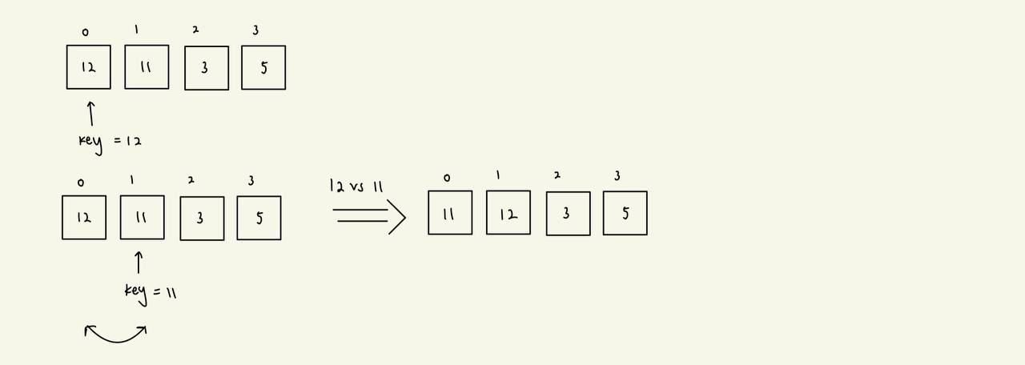
Since S <= 4 now, we carry out InsertionSort
Key = 12
Key = 11

Slide 6
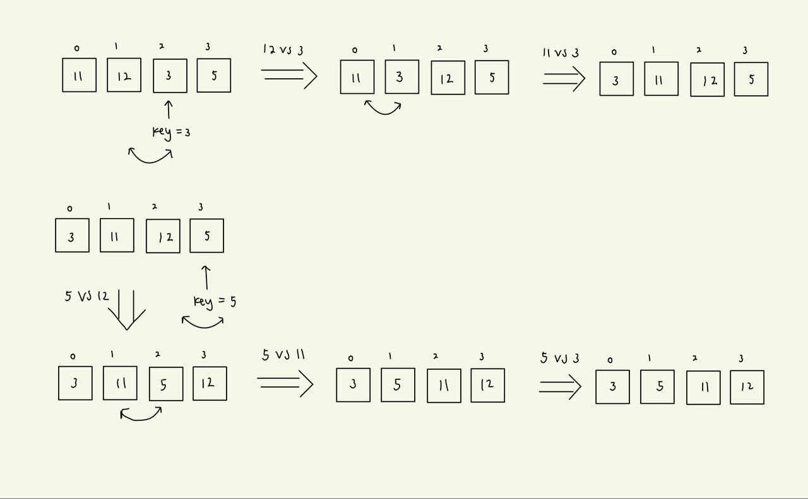
Key = 3
Key = 5

Slide 7
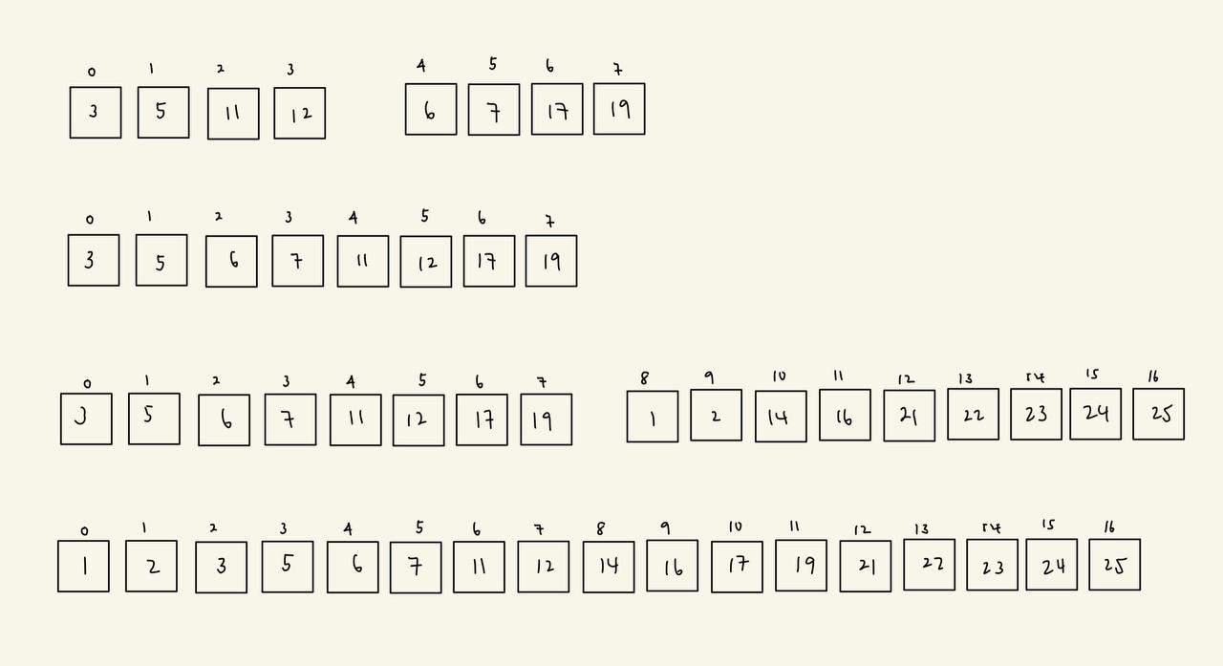

Slide 8
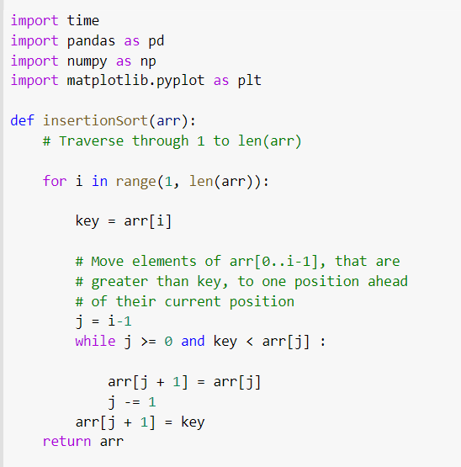
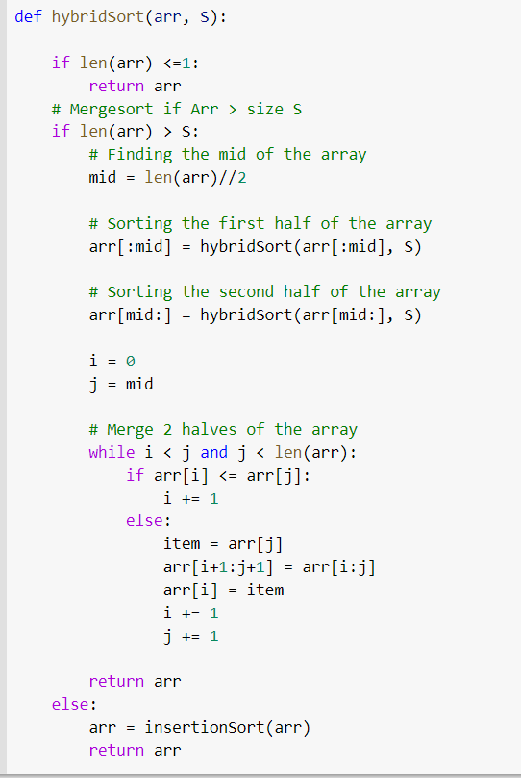

Slide 9
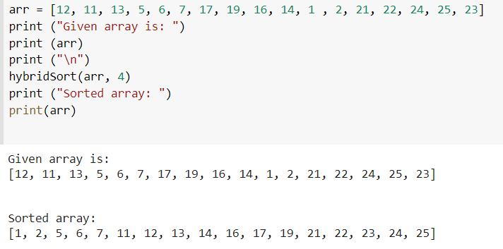

Slide 10
Time Complexity
Average and worst case
n-1
n
(n/2 -1) + (n/2 - 1) = n-2
n/2
n/2
Log (n/S) levels of merging
(n/4 - 1) + (n/4 - 1) + … = n-4
n/4
n/4
n/4
n/4
.
.
.
.
.
.
.
.
.
.
.
.
.
.
.
.
.
.
.
.
.
.
.
.
S
S
S
S
S
S
S
S
S
S
S
Perform InsertionSort here (time complexity depends on best, average or worst case)
n/S lists
Notes:
We use a recursion tree to show the time complexity of hybridsort. So the recursion tree divides the arrays into subarrays until it reaches a value less than S.

Slide 11
Time Complexity
For average and worst case,
T(n) = n-1 + n-2 + n-4 + … + n/S (I(S)) where I(S) is the time complexity of the insertion sort
log(n/S) terms
= nlog(n/S)- (1 + 2 + 2² + … ) + n/S (I(S))
= nlog(n/S)- (n/S - 1) + n/S (I(S)) (using sum of geometric series)
Best Case:
T(n) = = (n/(2s))log(n/S) + n/S (S-1)
Average Case:
T(n) = = nlog(n/S)- (n/S - 1) + n/S ((S+2)(S-1)/4)
Worst Case:
T(n) = = nlog(n/S)- (n/S - 1) + n/S (S(S-1)/2)

Slide 12
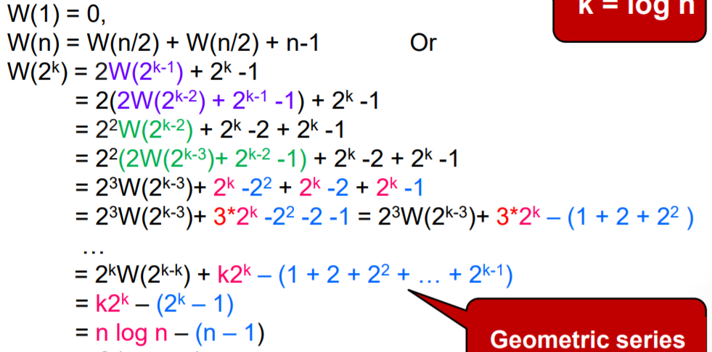
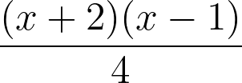
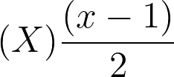



Our hypothesis
Time complexities of insertion sort in terms of key comparisons from best to worst:
Best: Average: Worst:
Time complexities of merge sort in terms of key comparisons from best to worst:
Best: Worst:
(Avg case could not be found/ derived except for large n from online sources, in which case it is approximately 0.2645(x) less than worst case).

Slide 13
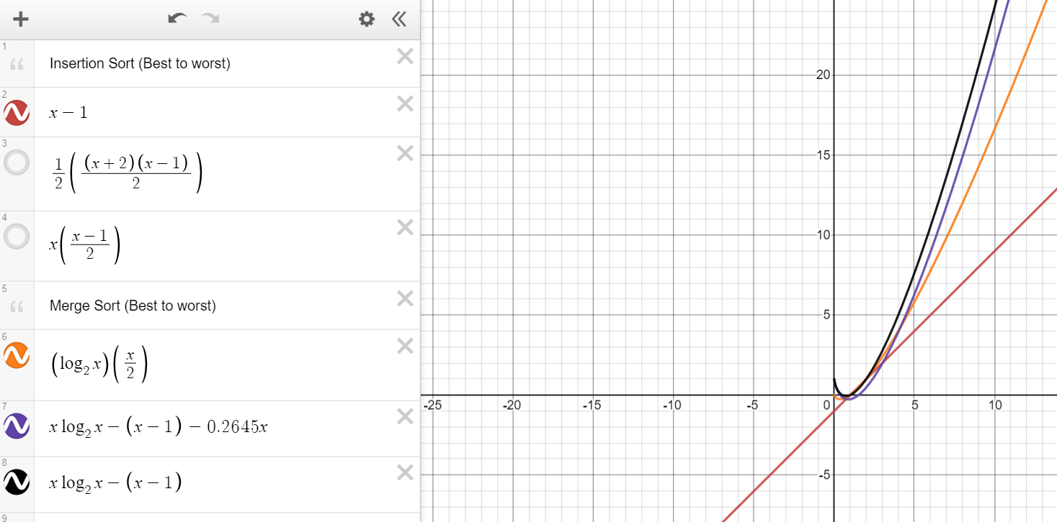
Best case Insertion Sort
vs
Merge Sort
Notes:
Plotting all 5 (6 including avg case for merge sort) graphs, we see that all intercepts between insertion sort and merge sort are trivial (1-2), except for the average case of insertion sort with the worst case of merge sort, which intersects at x=7.28 (in the best case of a sorted list, insertion sort takes linear time, so it is always faster than merge sort).
However, this value was obtained solely using key comparisons, and does not take into account any other overhead.

Slide 14
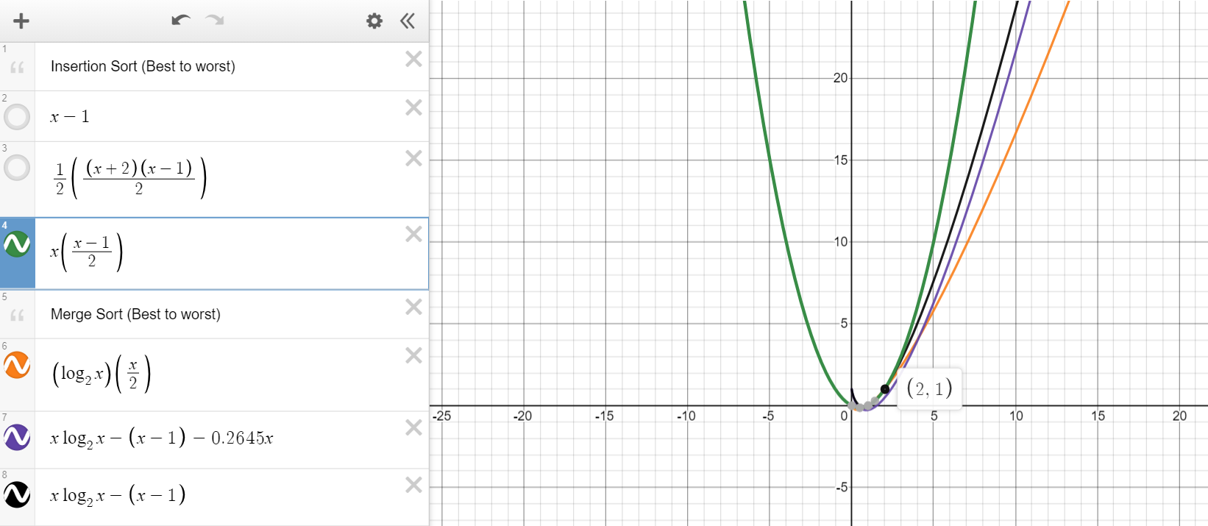
Worst case Insertion Sort
vs
MergeSort

Slide 15
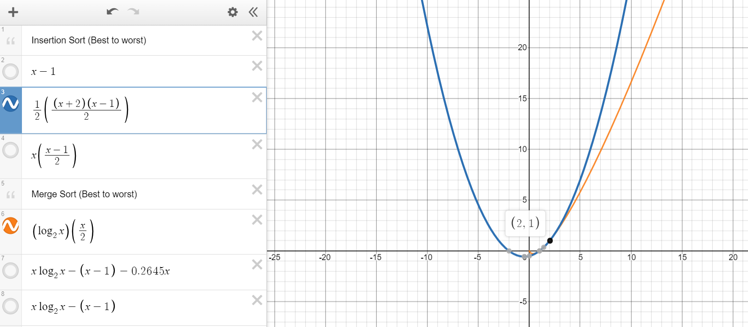
Average case Insertion Sort
vs
Best case Merge Sort

Slide 16
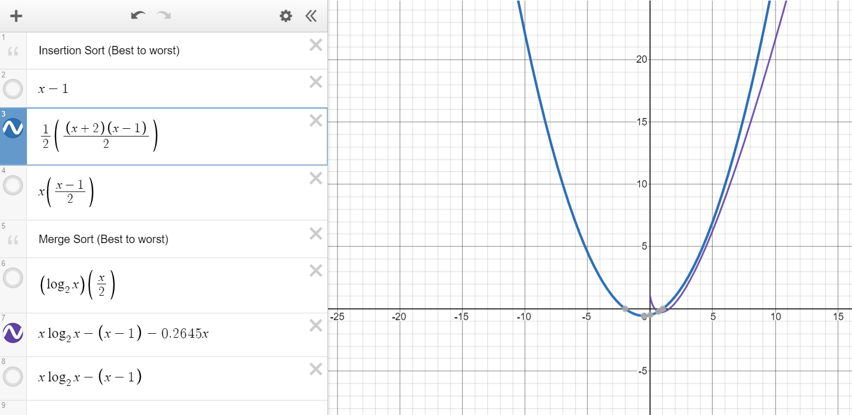
Average case Insertion Sort
vs
Average case Merge Sort

Slide 17
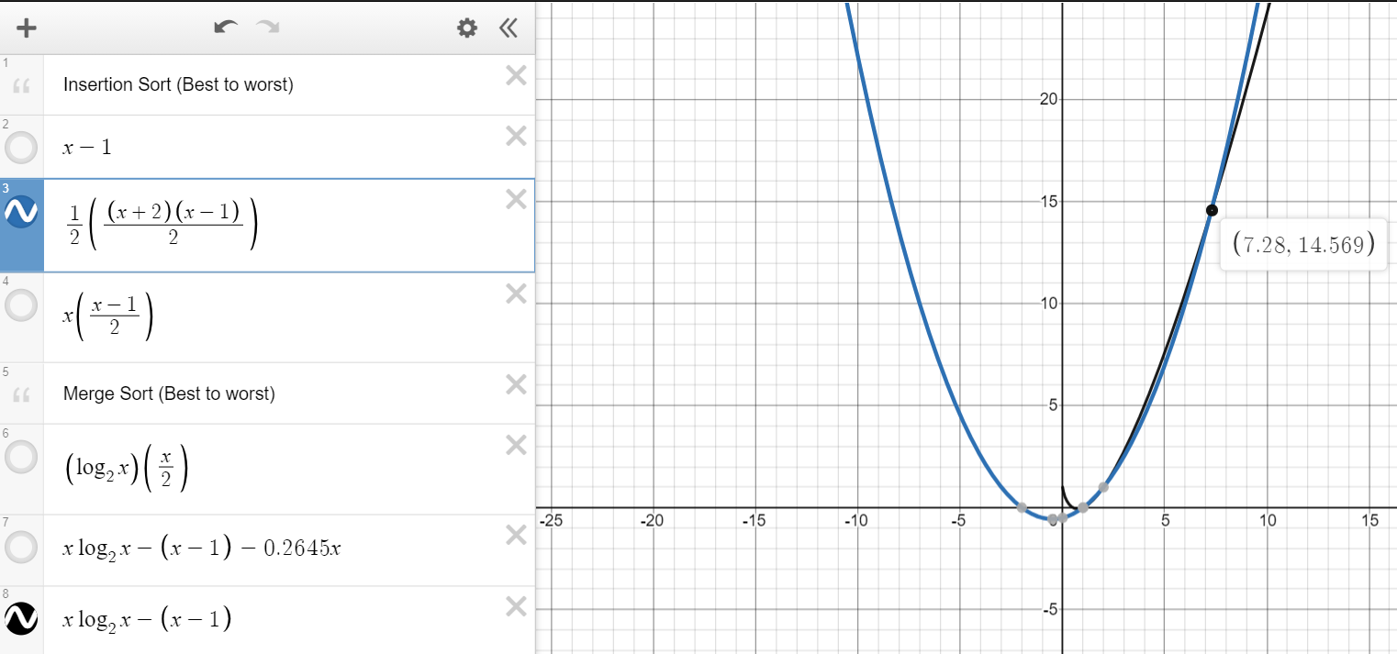
Average case Insertion Sort
vs
Worst Case Merge Sort

Slide 18
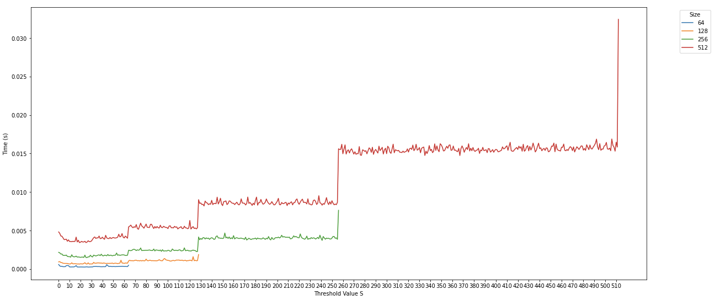
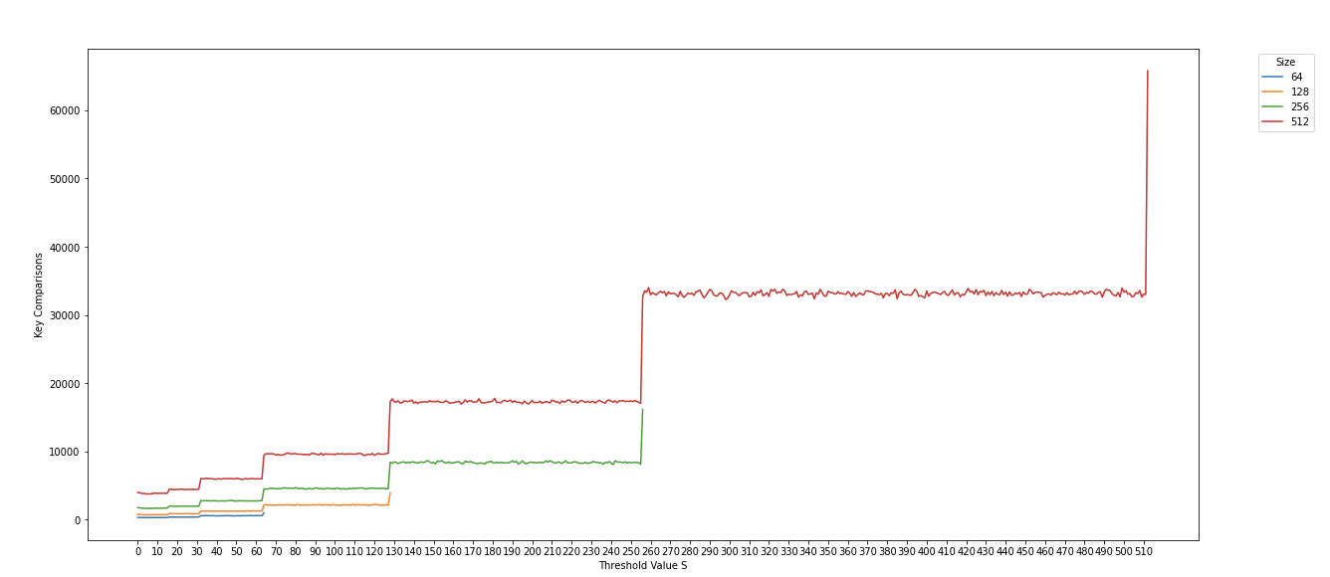
Testing our hypothesis
Notes:
It displays a stepwise graph, where the graph remains stable from $\frac{n}{2^{k+1}}$ to $\frac{n}{2^k} - 1$ and jumps from $\frac{n}{2^k}-1$ to $\frac{n}{2^k}$ for k = 0,...,logn. This is an expected result. Suppose n = 256 and it splits to 128 and 128. For values of S between 128 and 255, they will run in approximately the same time as insertionsort will be performed at the same level of recursion. However, when S is between 64 and 127, insertionsort will only be performed at the next level of recursion where the subarrays are 64 so it will cause a huge time difference between S = 127 and S = 128.

Slide 19
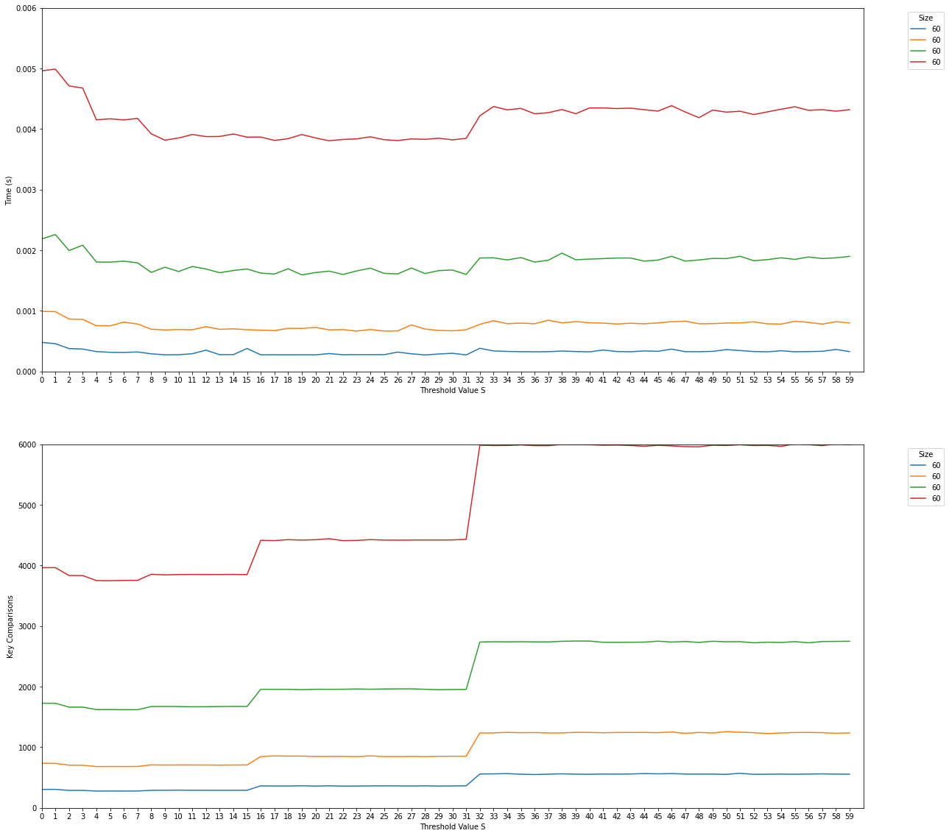
Testing our hypothesis
(insert key comparisons for different values of S) 128, 200, 256, 350, 512
Notes:
Although for all input sizes, the minimum number of key comparisons appears to occur when our threshold is in the range of 5-10, when we look at actual runtime we see that the distribution of the graph appears to change. Specifically, the value of our threshold is higher than expected for minimised runtime. This corroborates with the initial hypothesis of the project, which is that the overhead of many recursive calls in merge sort also has an impact on our runtime. In our case, S appears to work better at s=9 as compared to s=7.

Slide 20
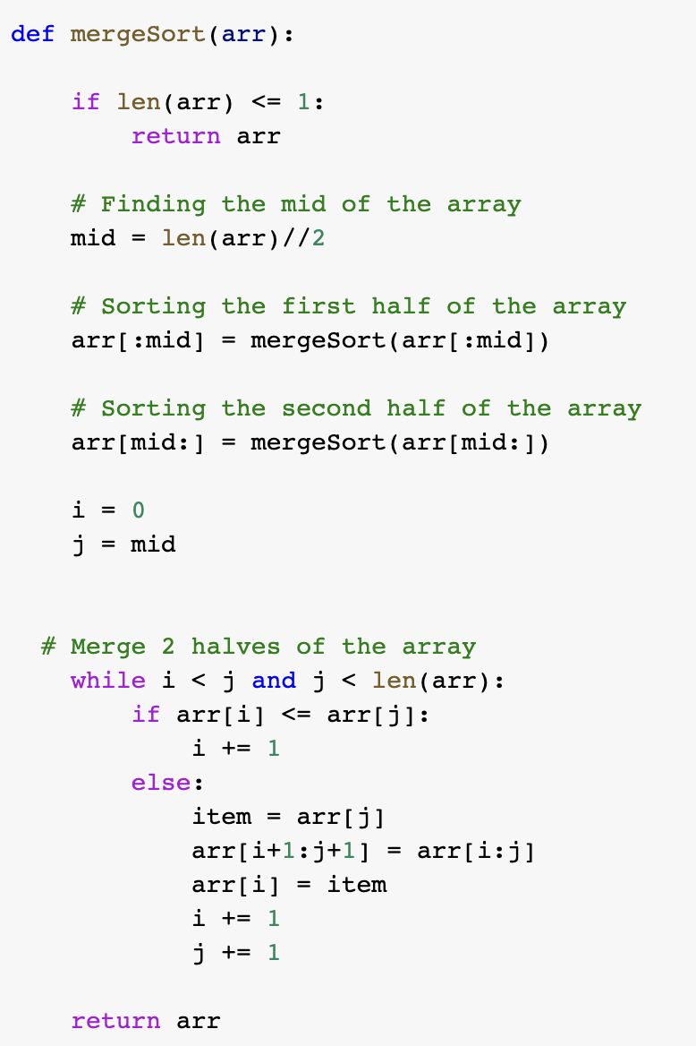
Comparing with
non-hybrid MergeSort

Slide 21
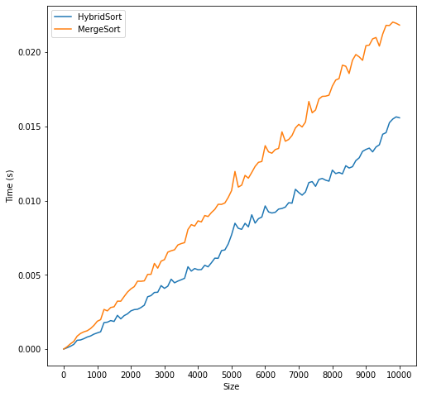
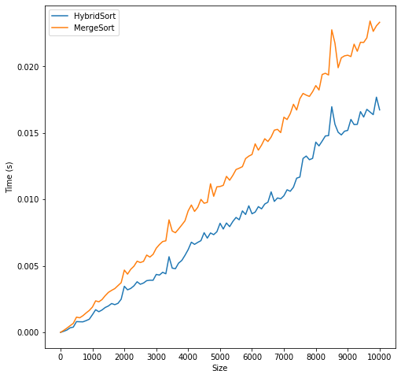
Comparing with non-hybrid MergeSort
Best Case
s=9
s=7

Slide 22
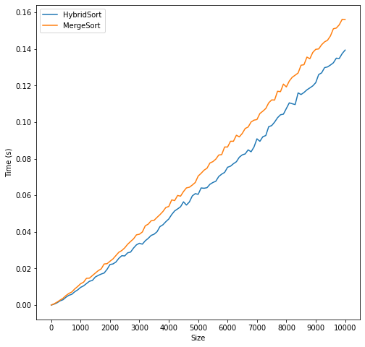
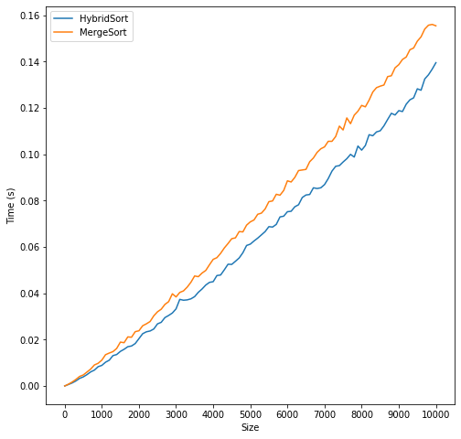
Comparing with non-hybrid MergeSort
Average Case
s=9
s=7

Slide 23
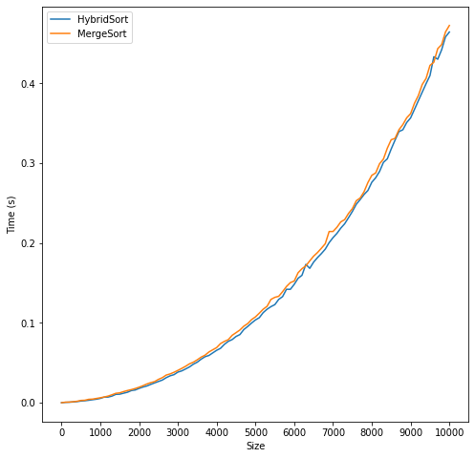
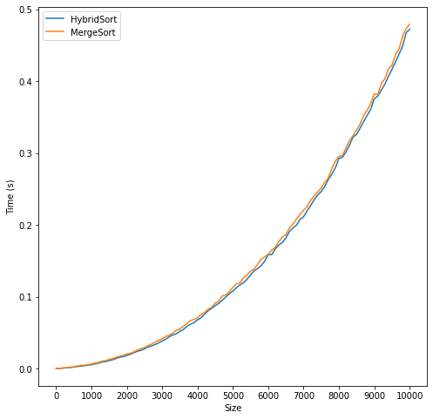
Comparing with non-hybrid MergeSort Worst Case
s=9
s=7

Slide 24
Comparing with non-hybrid MergeSort
Using the threshold value experimentally obtained in part (a), we see that hybrid sort does in fact beat out merge sort in all cases for runtime, albeit only marginally in the worst case. We can also observe a slight difference in the best & average case graphs when using threshold values of S=7 and S=9.

Slide 25
Conclusion
We observe that hybrid sort works better than merge sort in every case (marginally with the worst case).
Choosing a threshold value of S=9 works better in real world use as compared to using S=7 which was shown to work better when directly plotting the time complexity graphs and comparing them.

